Slide 1
Bloedel Fire (Sayward) 1938
Ignition:
July 5, 1938
Cause:
Sparks from yarding engine just north of
Campbell River

Slide 2
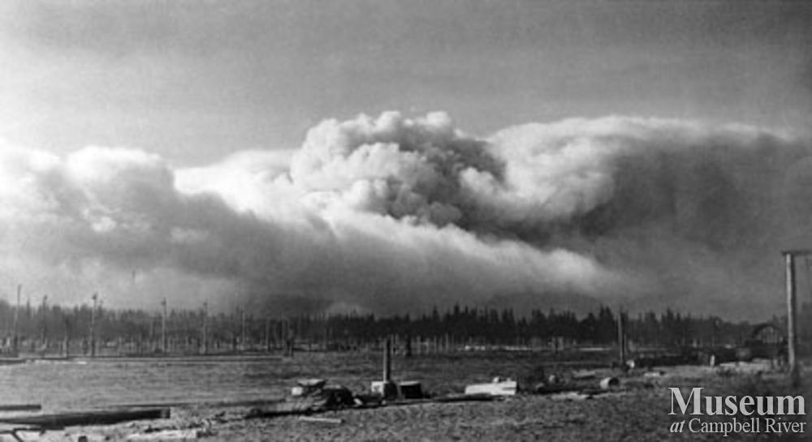
Bloedel Fire (Sayward) 1938
View from the Campbell River Estuary of the smoke.

Slide 3
Bloedel Fire (Sayward) 1938
“Tinder-dry woods are
like Dynamite”
B.C. Chief Forester
E.C. Manning
July 15, 1938

Slide 4
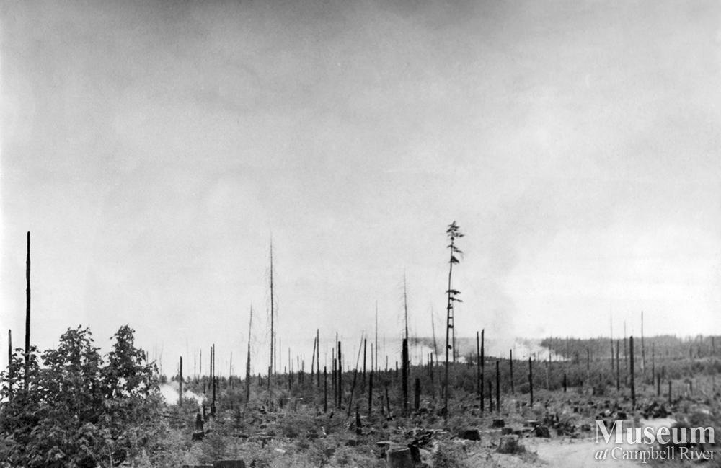
Bloedel Fire (Sayward) 1938
Fire advancing toward Forbidden Plateau

Slide 5
Bloedel Fire (Sayward) 1938
The fire consumed
more than
30,00 hectares
(75,000 acres)
of forest.

Slide 6
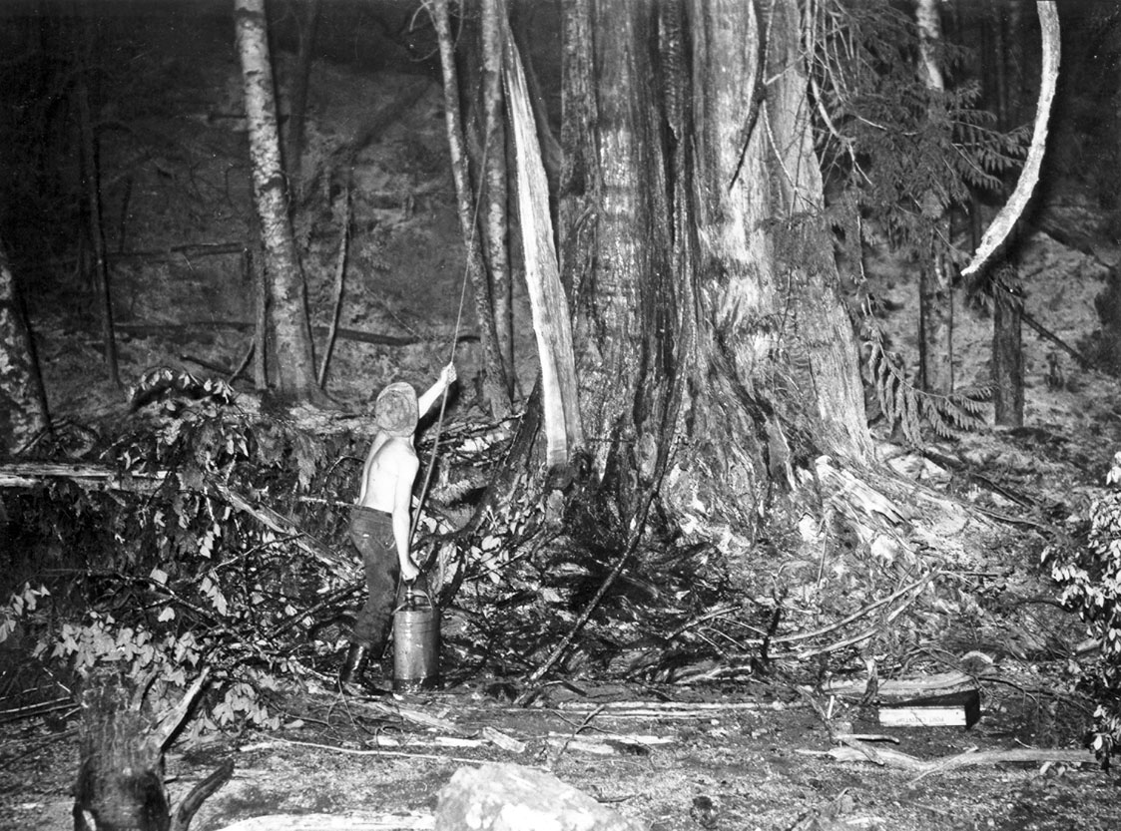
Bloedel Fire (Sayward) 1938

Slide 7
Bloedel Fire (Sayward) 1938
Logging practices
of the time had left abundant slash fuels, which contributed to
it’s rapid spread.

Slide 8
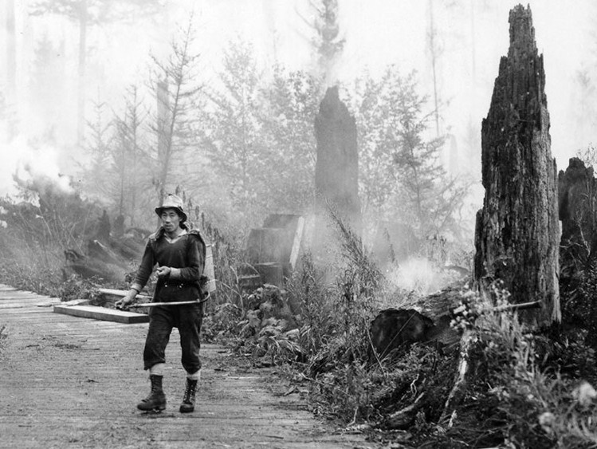
Bloedel Fire (Sayward) 1938

Slide 9
Bloedel Fire (Sayward) 1938
Unemployed men from as far away as Vancouver were hired to fight the fire for 25 cents an hour.

Slide 10
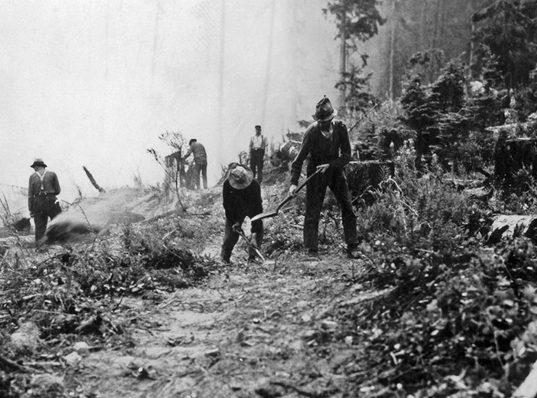
Bloedel Fire (Sayward) 1938

Slide 11
Bloedel Fire (Sayward) 1938
It took 1,500 men
one month to control
the fire, which was finally put out by rain.

Slide 12
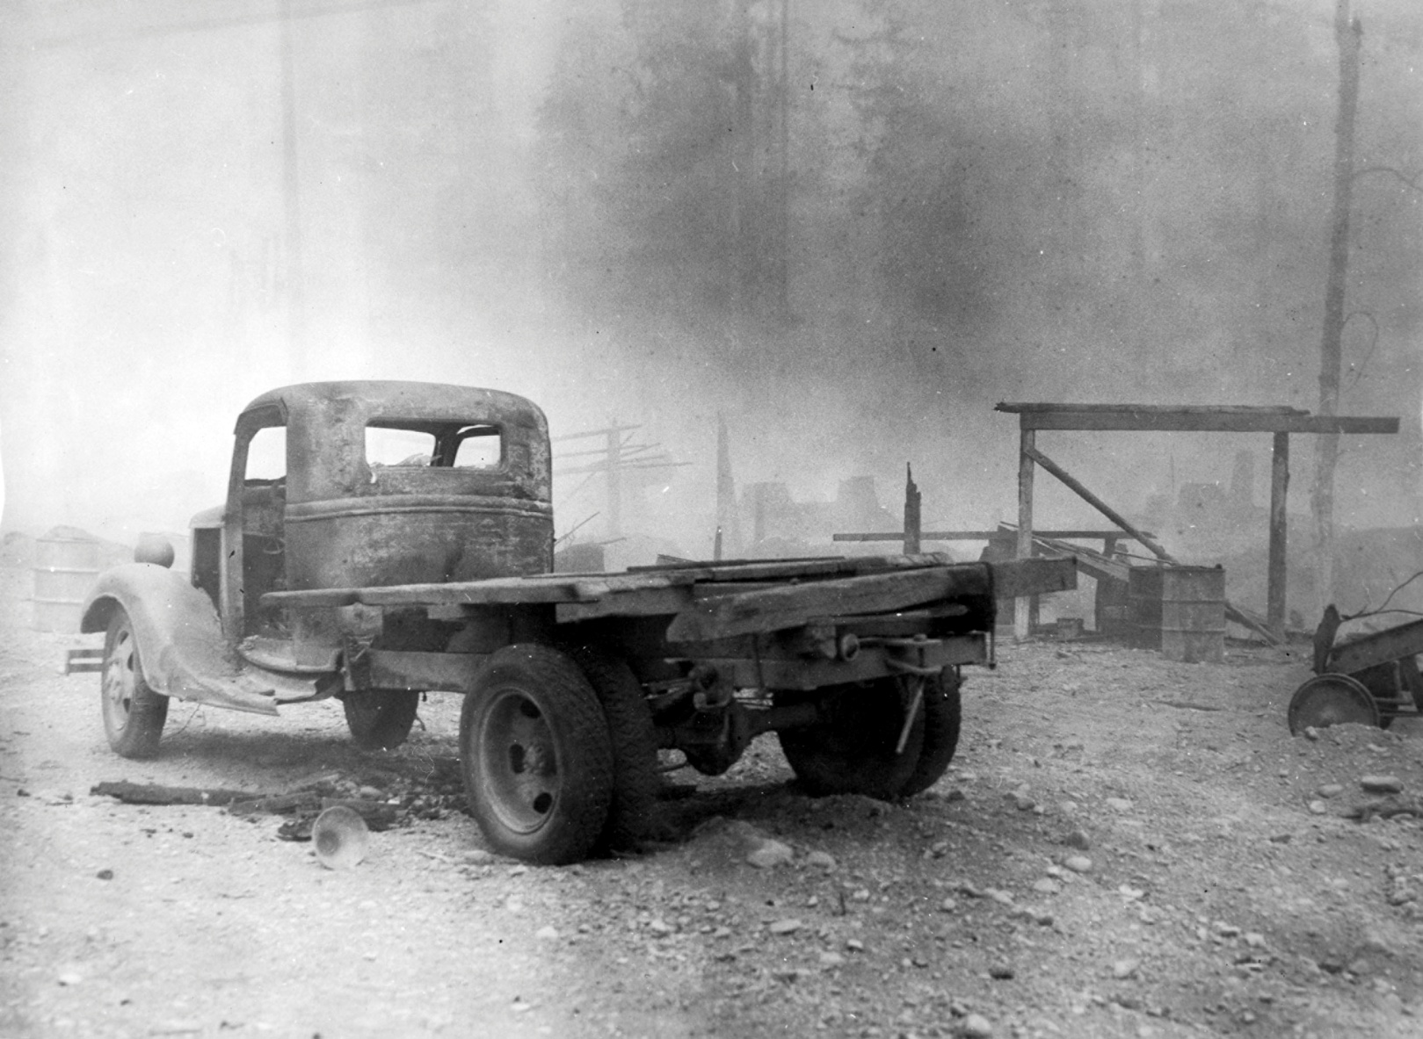
Bloedel Fire (Sayward) 1938

Slide 13
Bloedel Fire (Sayward) 1938
No lives were lost
Timber and property amounted to $780,000
(in 1938 funds)
(today’s equivalent would be tens of millions of dollars)

Slide 14
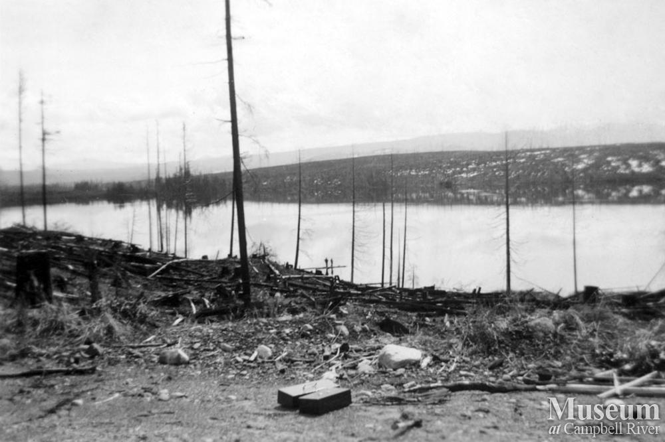
Bloedel Fire (Sayward) 1938
The fire stretched from Campbell Lake to Comox
Beavertail Lake on the Elk River Camp 8 road.

Slide 15
Bloedel Fire (Sayward) 1938
The fire stretched from Campbell Lake to Comox

Slide 17
Bloedel Fire (Sayward) 1938
Up to the time of the Sayward fire,
reforestation after a wildfire in BC was accomplished through natural reforestation.

Slide 18
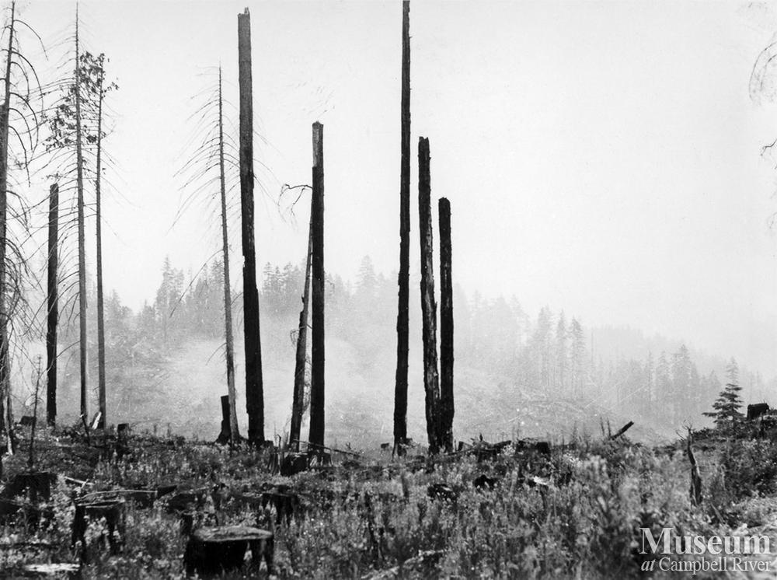
Bloedel Fire (Sayward) 1938
After the fire

Slide 19
Bloedel Fire (Sayward) 1938
It was realized that without a massive artificial reforestation effort, the Sayward would never again be a productive forest.

Slide 20
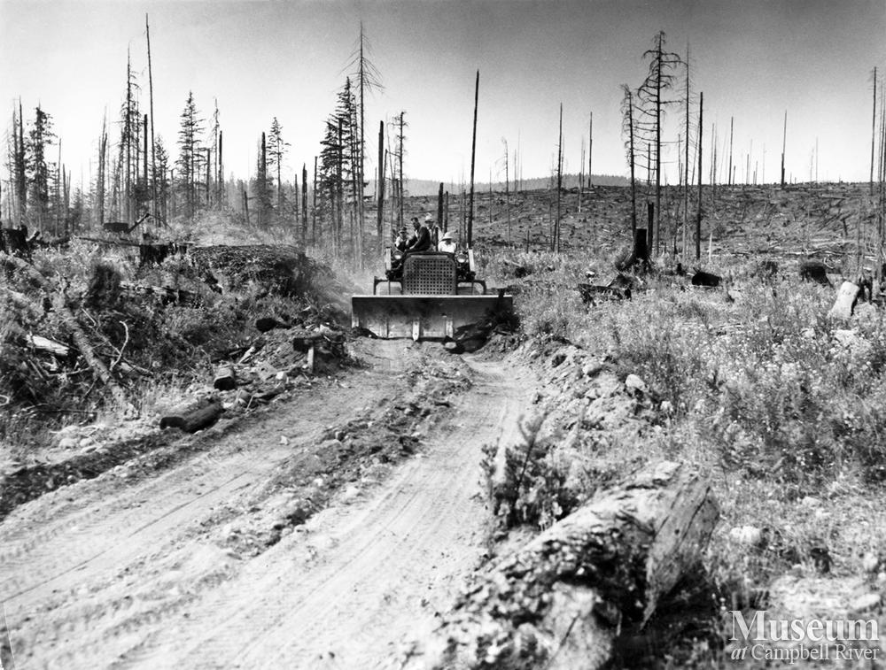
Bloedel Fire (Sayward) 1938
Clearing forest debris

Slide 21
Bloedel Fire (Sayward) 1938
In 1939, work started on the largest planting project ever in B.C.
The area was the size of Quadra Island.
This was a massive undertaking for the time.

Slide 22
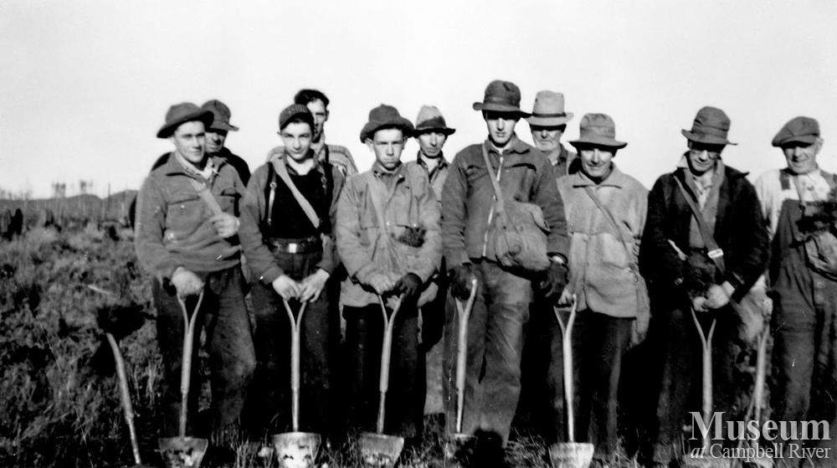
Bloedel Fire (Sayward) 1938
Tree planting crew after the Sayward fire

Slide 23
Bloedel Fire (Sayward) 1938
In one month, 763,550 seedlings were planted.
This project launched the B.C. reforestation program.

Slide 24
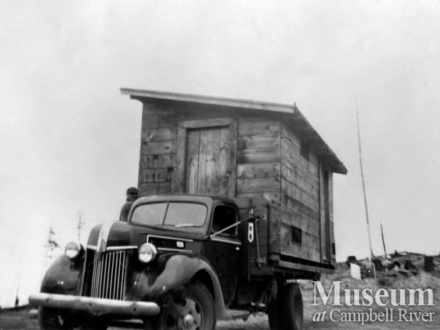
Bloedel Fire (Sayward) 1938
Moving the meat house
Part of tree planting camp from Loveland Lake to Lawson Lake.
One of the many tree planting camps replanting after the Sayward Fire.

Slide 25
Bloedel Fire (Sayward) 1938
Today, the Sayward forest is again producing lumber.

Slide 26
Bloedel Fire (Sayward) 1938
“The Sayward Forest... stands as a living showcase for the benefits of silviculture...

Slide 27
Bloedel Fire (Sayward) 1938
“... It also stands as a monument to the hard work and dedication of many... without whose effort none of this would have been possible.”
-Dave Parker, Minister of Forests 1988

Slide 28
The end...
of the beginning

